Slide 1

STRATA
Modern Data Engineering
for Disrupted Stacks
Survey · Triage · Right-Size · Assemble · Transfer · Advance
eumetix.nl | Data Engineering Services

Slide 2




The Opportunity
Data is your most valuable asset. The technology landscape surrounding it is evolving at an unprecedented pace.
Organizations that invest in modern data engineering capability today are building a durable competitive advantage. There are several reasons you may be embarking on this journey now:
Legacy & EOL
Greenfield
Strategic Initiative
Commercial Pressure
Existing tools have reached end-of-life, changed ownership, or no longer have sufficient capability.
A strategic opportunity has presented, to build data capitalization, analysis, or integration capability correctly from the outset.
AI readiness, advanced analytics, regulatory compliance — driving the need for a reliable data foundation.
The current platform works, but the renewal conversation has changed. The commercial model no longer reflects the value delivered.
Regardless of where you are starting from, the answer is rarely the most expensive option in the market — but it is always a modern, open, and appropriately scaled one.

Slide 3
The False Choice
When it’s time to build or modernize your data engineering capability, the market presents three options. None of them are quite right.
A
Commit to a “turnkey” enterprise platform
Significant license cost. Multi-year contracts. Sized and priced for an organization larger than yours.
B
Move to a hyperscaler stack
Capable, but pricing scales against you as your data grows. And your data always grows.
C
Do nothing, or patch what you have
Technical debt compounds. Strategic initiatives stall. The gap between where your data is and where it needs to be gets wider.
There is a fourth option.

Slide 4
Introducing STRATA
A practitioner framework for data engineering that is cost-optimized, right-sized, and built to last.
S
T
R
Survey
Triage
Right-Size
Inventory everything. Understand what exists before touching anything.
Classify by risk and complexity. Sequence the migration intelligently.
Design for your actual scale — not a vendor's enterprise template.
A
T
A
Assemble
Transfer
Advance
AI-accelerated engineering delivery on the open-source stack.
Full documentation and handoff — or retained operations. Your choice.
Continuous improvement. The platform is a foundation, not a finish line.

Slide 5
The Open Stack
Open-source first. Standards-based. No proprietary lock-in.
Ingestion / ELT/ ETL
Apache Hop
GUI-based pipeline authoring. Familiar to anyone from the legacy ETL world.
Analytics Engineering
dbt
SQL-first. Version-controlled. Testable. The modern standard.
Orchestration
Apache Airflow
Schedules Hop jobs and dbt runs. Extensive ecosystem.
Storage Format
Apache Iceberg
Open table format. Time travel. Schema evolution. No warehouse lock-in.
Platform Operations
Stackable
Kubernetes operators for the full stack. The glue that makes it deployable.
BI / Reporting
Metabase
Self-serve analytics. Approachable. Self-hosted and hosted options.

Slide 6

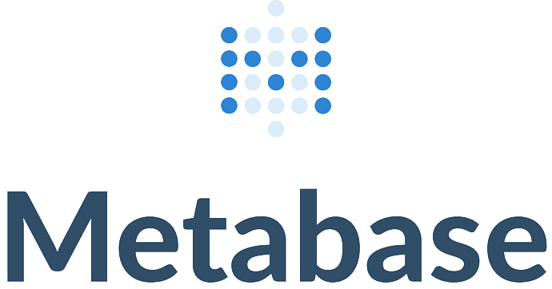

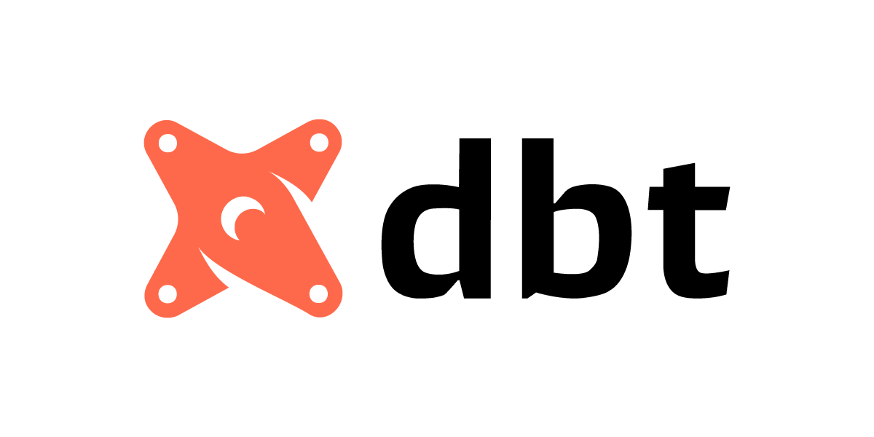

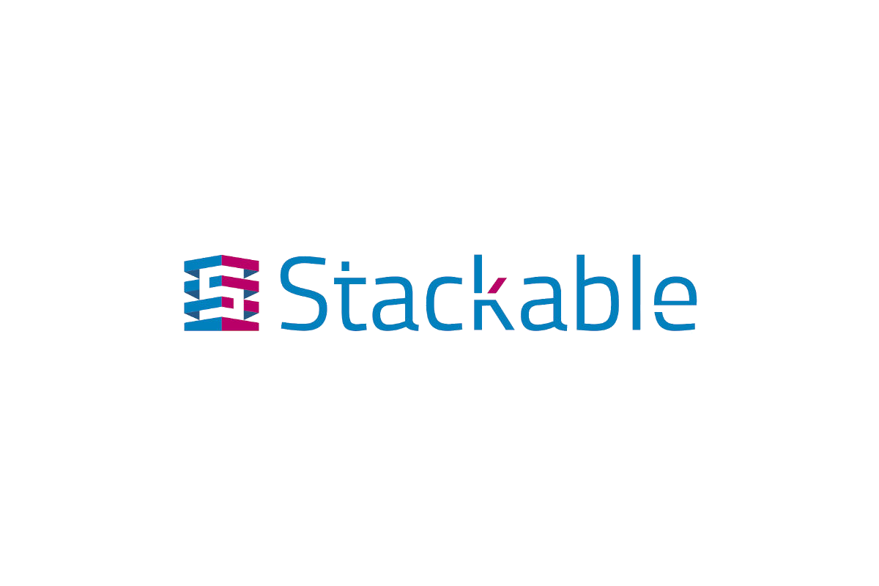
Built on Open-Source Foundations
Open-source. Standards-based. No proprietary lock-in.

Slide 7
Example Datalake Reference Architecture
Analytics & AI Readiness · Open-source stack · Deployed via Stackable on Kubernetes
Stackable Data Platform · Kubernetes Operators
DATA SOURCES
APACHE HOP
APACHE ICEBERG
METABASE
AIRFLOW
ERP / ERP CDC
Pipeline Ingestion & ETL
Open Table Format · S3-Compatible Storage
BI & Self-Serve Analytics
Orchestration
· Source connectors
· Raw layer (bronze)
· Interactive dashboards
· DAG scheduling
CRM
· Schema mapping
· Validated layer (silver)
· Ad-hoc SQL queries
· Hop job triggers
SaaS APIs
►
· Data type coercion
►
· Curated layer (gold)
· Scheduled reports
►
· Dependency mgmt
Relational DBs
· Incremental / CDC load
· Snapshot / time travel
· Iceberg direct connect
· SLA monitoring
Flat Files / CSV
· Error handling & retry
· Schema evolution
· Role-based access
· Iceberg writer
· MinIO / R2 / S3
· Self-hosted option
· Retry & alerting
Streaming Events
AI Readiness: Iceberg gold layer serves as the clean, versioned, auditable data foundation for ML feature stores, LLM pipelines, and analytics AI — no additional ETL required.

Slide 8

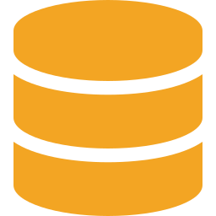


AI-Accelerated Delivery
AI accelerates delivery. Engineers own the output. The two are not the same thing.
Pipeline Scaffolding
dbt Model Generation
Hop job structures generated from plain-language specifications. Engineers review and refine.
SQL transforms drafted from source/target descriptions. Ready for review in minutes, not days.
DAG Generation
Documentation
Airflow DAGs produced from orchestration requirements. No boilerplate from scratch.
Automated first-draft docs for every pipeline — reviewed and approved before delivery.

Slide 9




Why Eumetix
Services-first. Engineering-led. Open-source committed.
Not About Our Favored Vendors
We recommend what's right. We build what works.
Delivery Focused.
The work product is a working data ecosystem, not a slide deck.
Open-Source Committed
The stack is yours. No proprietary components that disappear when the vendor decides.
AI-Accelerated Velocity
We deliver faster using AI tooling — without compromising engineering quality or ownership.

Slide 10
Let's Start With a Conversation
No commitment. No presupposition about what the answer is.
01
02
03
Discovery Call
Pipeline Inventory
Proposal
30 minutes. Tell us what you're running, what's happening to it, and what keeping you up at night.
We'll help you assess what you have and what it would take to move it. No obligation, concrete output.
A specific scope, timeline, and cost — sized for your actual environment, not a boilerplate estimate.
Eumetix | eumetix.nl | Data Engineering Services

